Slide 1
Introduction to Computers for Engineers: Recitation #1

Slide 2
Welcome to Recitation!
TA: Soo Min Kwon (Kenny)
Email: smk330@scarletmail.rutgers.edu
Website: soominkwon.github.io
Office Hours:
Online (by appointment)
CoRE 531 (by appointment & walk-ins)

Slide 3
How will Recitation Work?
Get into groups of 5 students max.
We will ask you to do activities every recitation.
Each activity will have questions that you can answer as a group, however:
Everybody should code individually
Groups should talk to each other about the code they are writing, ask each other questions
Groups should keep track of progress on the recitation worksheet each week
Available on Canvas
The whole class will review each activity before moving on to the next

Slide 4


Recitation 1 – Activity 1
Find the command window in MATLAB
Create the following variables:
Find the workspace in MATLAB
Find and double click on the name of both variables.
Question: What are the data types for these two variables?
Run the following code in the command window:
Question: What are the values for these two new variables? How are they different and why?
Notes:
12 min

Slide 5
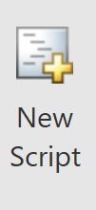
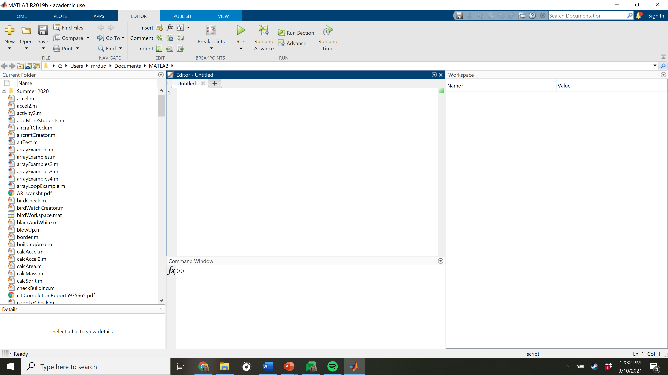
Recitation 1 – Activity 2
Find the “New Script” button in MATLAB and press it
In your new script, create the following:
A Double precision floating point decimal (aka a double)
A row array of doubles
A column array of doubles
A character
A string
A numerical variable created using another numerical variable and an operator
Save your script. Name your script “recitation_one.m”. Remember that you cannot have spaces in the name.
Press Run.
Now write a comment for each line of code and run the script.
Question: Did commenting your code affect the outcome of your code?
Question: Why might comments in your code be useful?
Question: Why might working with scripts be useful?
Notes:
15 min

Slide 6
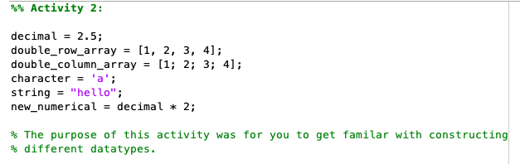
Recitation 1 – Activity 2

Slide 7
Recitation 1 – Activity 3
In the command window, write a few lines of code.
In the command window, type clc .
Question: What happened to the command window and workspace?
Type clear all in the command window.
Question: What happened to the command window and workspace?
Write a line of code without a semicolon.
Write the same line of code with a semicolon.
Questions:
Look at the command window and the workspace. What was different?
While in the command window, press the up and down arrows on your keyboard. What do they do?
Type the name of the script you created last activity. What happened?
Notes:
12

Slide 8
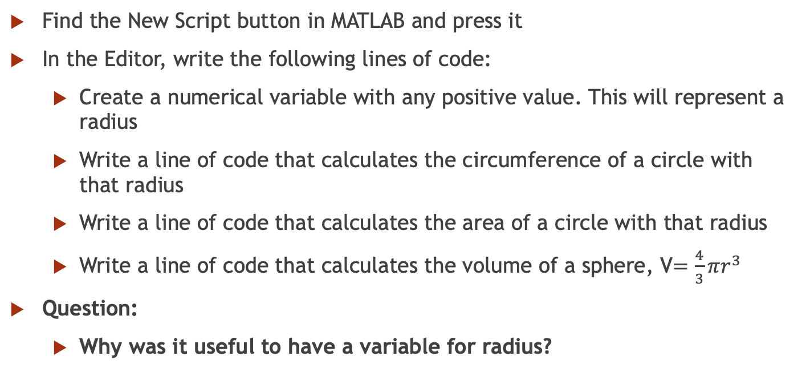
Recitation 1 – Activity 4
Find the New Script button in MATLAB and press it
In the Editor, write the following lines of code:
Create a numerical variable with any positive value. This will represent a radius
Write a line of code that calculates the circumference of a circle with that radius
Write a line of code that calculates the area of a circle with that radius
Write a line of code that calculates the volume of a sphere, V$=\frac{4}{3}πr^{3}$
Question:
Why was it useful to have a variable for radius?
Notes:
10 min

Slide 9
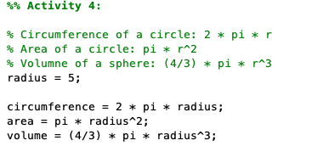
Recitation 1 – Activity 4

Slide 10
Wrap Up
The Semester Cheat Sheet!

